Slide 1
MODULE 2: HYDROGEN ENERGY FUEL CELLS

Slide 2
OUTLINE
Hydrogen: Introduction & its properties
Hydrogen Production Methods
Hydrogen Accidents & Safety
Hydrogen Storage
Fuel cells
Hydrogen Refuelling Infrastructure

Slide 3
HYDROGEN:BASICS
Hydrogen is a colorless, odorless, tasteless, and nonpoisonous gas at STP
It typically exists as a diatomic molecule (H2)
Most abundant element in the Universe making up 75% of the normal matter
Available on earth in bound form only in water, all fossil fuels and organic matters
Its concentrations in air is about 100 ppm (0.01%)
Releases energy and forms water on reaction with air - making it ultimate green fuel
Flammable and burns with a pale-blue color

Slide 4
HYDROGEN: FUEL OR AN ENERGY CARRIER
It is most abundant element in universe — in combined form
However, hydrogen is not readily available in nature
It can be produced from hydrogen containing compounds by applying external source of energy in the form of heat, light or electricity
It has highest energy content by mass — 2.7 times of petrol
It is lightest of all elements (density of about 0.0898 kg/m3) and needs to be stored on-board at high pressure for providing enough driving range
Like electricity, hydrogen is an energy carrier that can be used for a wide range of applications in all sectors of economy

Slide 5
PROPERTIES OF HYDROGEN
Property | Hydrogen | Comparison
Density (gaseous) | 0.089 kg/m3 (OOC, 1 bar) | 1/10 of natural gas
Density (liquid) | 70.79 kg/m3 (-2530C, 1 bar) | 1/6 of natural gas
Boiling point | -252.760C (1 bar) | 900C below LNG
Energy per unit of mass (LHV) | 120.1 MJ/kg | 3x that of gasoline
Energy density (ambient cond.,LHV) | 0.01 MJ/L | 1/3 of natural gas
Specific energy (liquefied, LHV) | 8.5 MJ/L | 1/3 of LNG
Flame velocity | 346 cm/s | 8x methane
Ignition range | 4—77% in air by volume | 6x wider than methane
Auto-ignition temperature | 5850C | 2200C for gasoline
Ignition energy | 0.02 MJ | 1/10 of methane

Slide 6
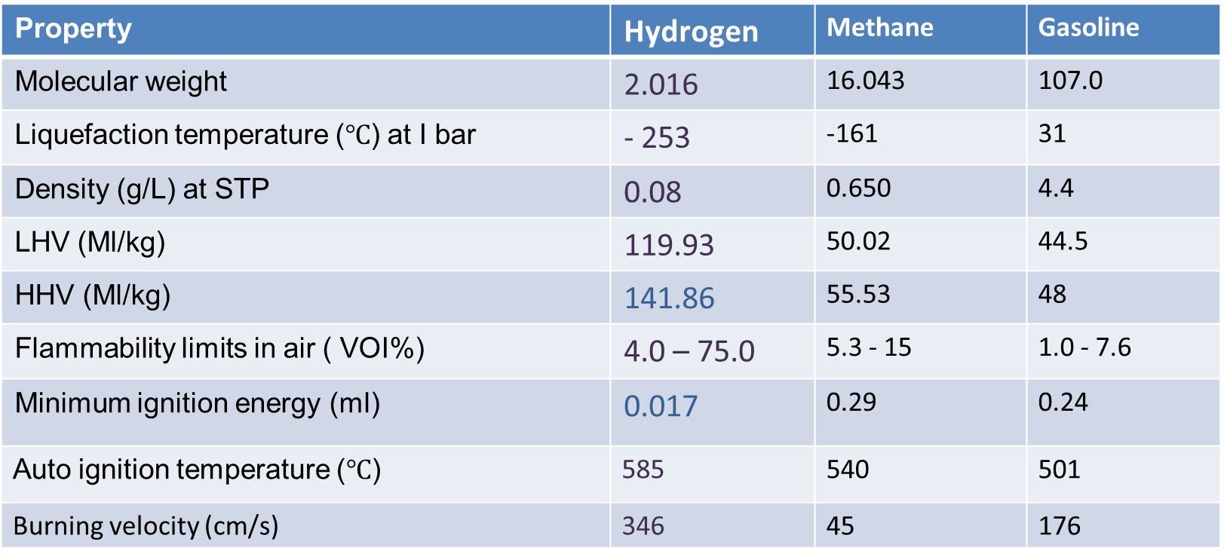
COMPARISON OF PROPERTIES OF HYDROGEN WITH OTHER FUELS
Property | Hydrogen | Methane | Gasoline
Molecular weight | 2.016 | 16.043 | 107.0
Liquefaction temperature ($℃$) at I bar | - 253 | -161 | 31
Density (g/L) at STP | 0.08 | 0.650 | 4.4
LHV (Ml/kg) | 119.93 | 50.02 | 44.5
HHV (Ml/kg) | 141.86 | 55.53 | 48
Flammability limits in air ( VOI%) | 4.0 – 75.0 | 5.3 - 15 | 1.0 - 7.6
Minimum ignition energy (ml) | 0.017 | 0.29 | 0.24
Auto ignition temperature ($℃$) | 585 | 540 | 501
Burning velocity (cm/s) | 346 | 45 | 176

Slide 7
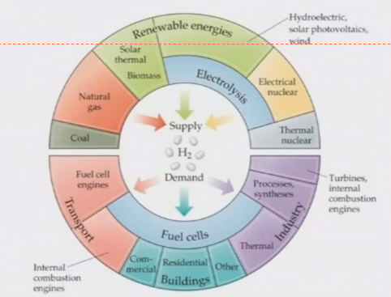
HYDROGEN ECONOMY
Supply
Hydrogen production
Storage
Hydrogen storage & transport
Demand
Application of hydrogen

Slide 8
Thank You

